Slide 1
Conversational interfaces in the browser
Web Directions Code @LeonieWatson

Slide 2
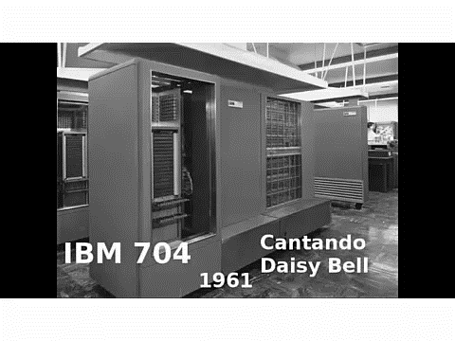
Daisy Bell

Slide 3
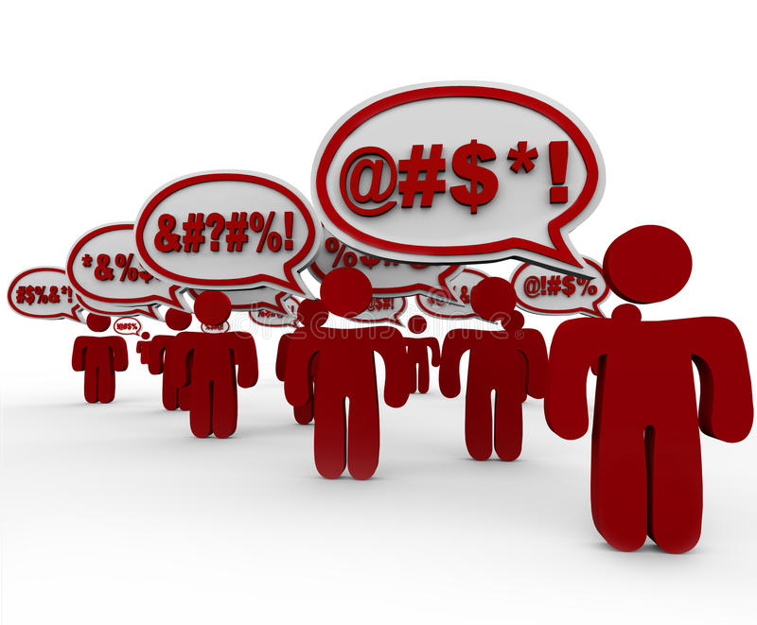
Conversation is text

Slide 4

Formant TTS
“For millions of years humans lived just like the animals. Then something happened that unleashed the power of our imagination; we learned to talk.”

Slide 5
Concatenative TTS
“For millions of years humans lived just like the animals. Then something happened that unleashed the power of our imagination; we learned to talk.”

Slide 6
Meet Q
“Hello, I'm Q, the world's first genderless voice assistant.
I'm created for a future where we're no longer defined by gender, but rather, how we define ourselves.
My voice was recorded by people who neither identify as male nor female and then altered to sound gender neutral, putting my voice somewhere between 145 and 175 Hertz.
But, for me to become the third option for voice assistants, I need your help. Share my voice with Apple, Amazon, Google, and Microsoft, and together we can ensure that technology recognises us all.
Thanks for listening. Q.”

Slide 7
Parametric TTS
“For millions of years humans lived just like the animals. Then something happened that unleashed the power of our imagination; we learned to talk.”

Slide 8
Neural TTS
“For millions of years humans lived just like the animals. Then something happened that unleashed the power of our imagination; we learned to talk.”

Slide 9

Web Speech API
Draft Community Group Report (2012)
Draft Community Group Report (2020)

Slide 10
Interfaces
SpeechRecognition interface
SpeechSynthesis interface

Slide 11
SpeechRecognition interface
const recog = new webkitSpeechRecognition();

Slide 12
Events
audiostart /audioend
soundstart / soundend
start / end
result
error

Slide 13
Methods
start
stop
abort

Slide 14
Permissions
recog.onerror = (event) => {
if (event.error == "not-allowed") {
output.innerText = "Please grant permission to use your microphone";
}
}

Slide 15
Transcript
recog.onresult = (event) => {
let transcript = event.results[0][0].transcript;
output.innerText = transcript;
}

Slide 16
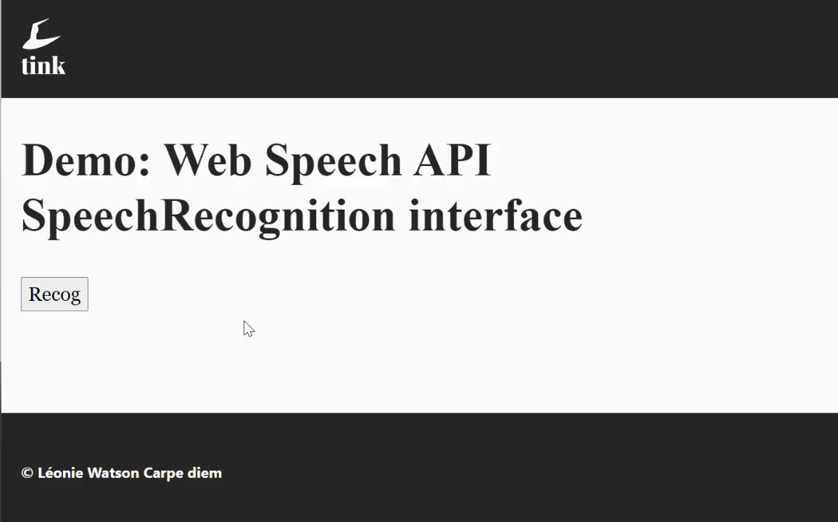
SpeechRecognition demo

Slide 17
SpeechSynthesis interface
var utterance = new SpeechSynthesisUtterance();
utterance.text = "This must be Thursday. I never could get the hang of Thursdays.";

Slide 18
Pitch
var utterance2 = new SpeechSynthesisUtterance();
utterance2.text = "2 tequila";
utterance2.pitch = 5;
window.speechSynthesis.speak(utterance2);

Slide 19
Rate
var utterance3 = new SpeechSynthesisUtterance();
utterance3.text = "3 tequila";
utterance3.rate = 2;
window.speechSynthesis.speak(utterance3);

Slide 20
Volume
var utterance4 = new SpeechSynthesisUtterance();
utterance4.text = "Floor!";
utterance4.volume = 1;
window.speechSynthesis.speak(utterance4);

Slide 21
Queue
window.speechSynthesis.speak(utterance1);
window.speechSynthesis.speak(utterance2);
window.speechSynthesis.speak(utterance3);
window.speechSynthesis.speak(utterance4);

Slide 22
Immutability
window.speechSynthesis.speak(utterance2);
utterance2.pitch = 4;

Slide 23
Voice
utterance.voice = "Microsoft Hazel desktop - English (Great Britain)";

Slide 24
Get voices
var voices = speechSynthesis.getVoices();

Slide 25
SSML
SSML 1.0 W3C Recommendation (2004)
SSML 1.1 W3C Recommendation (2010)

Slide 26
Alexa demo
let responsePrompt = `
<voice name='Enrique’>
<lang xml:lang='es-ES’>
<p>Hello, <break time='500ms'/> my name is Inigo Montoya.
You killed my father.
<break strength='x-strong'/>Prepare to die!
</p>
</lang>
</voice>`;

Slide 27
Web Speech demo
utterance.text = `
<?xml version=‘1.0’?>
<speak version=‘1.0’
xmlns=‘http://www.w3.org/2001/10/synthesis’
xml:lang=‘en-US’>
…
</speak>`;

Slide 28
Emotion ML
Emotion ML W3C Recommendation (2014)

Slide 29
Emotion ML demo
<emotionml>
<emotion>
<category name="surprised">Wow!</category>
<category name="disappointed">I was getting really tired of not being able to express myself.</category>
<category name="happiness">The future looks really exciting.</category>
</emotion>
</emotionml>

Slide 30
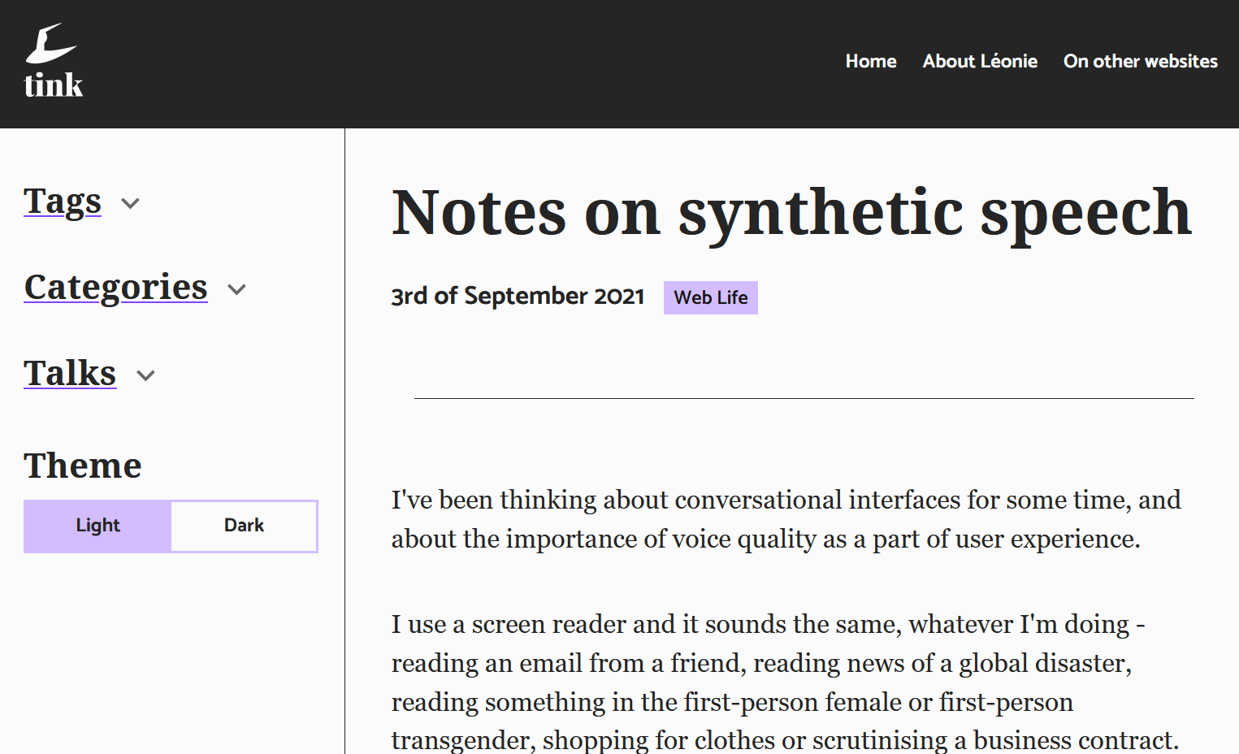
Reader mode

Slide 31
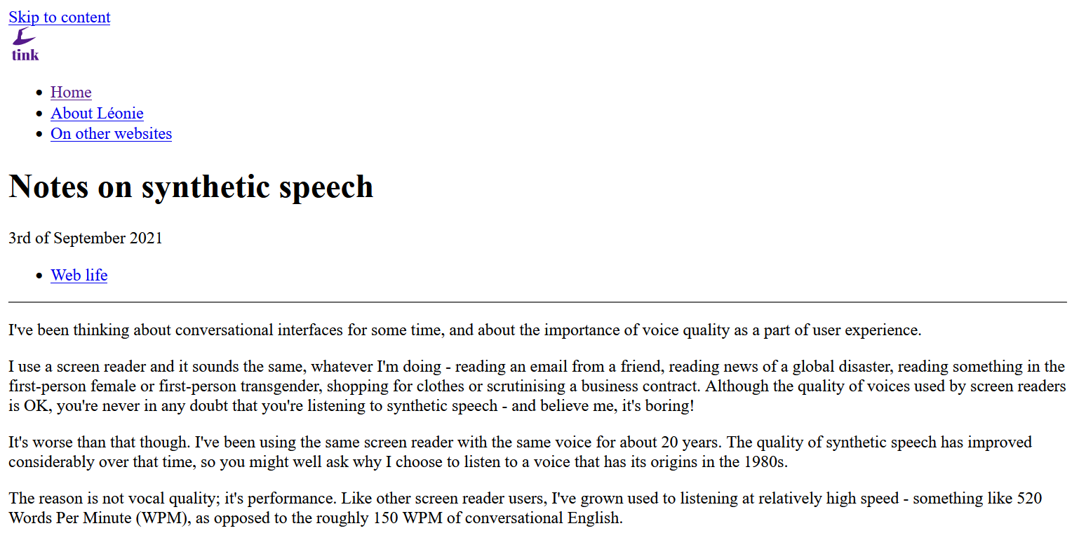
No style

Slide 32
CSS Speech
Working Group Note (2019)
W3C Candidate Recommendation (2020)

Slide 33
Media type
<link rel="stylesheet" media="speech" href="speech.css">

Slide 34
Speak
.content {
speak: auto;
}

Slide 35
Pitch
.content {
voice-pitch: x-low;
}

Slide 36
Rate
.content {
voice-rate: x-fast;
}

Slide 37
Volume
.content {
voice-volume: loud;
}

Slide 38
Pause
.content {
pause-after: strong;
}

Slide 39
Voice family
.content {
voice-family: McFly, young, male;
}

Slide 40
Content language
<p class="content" xml:lang="en-US">
Wait a minute Doc, uh, are you telling me you built a time machine … out of a DeLorean?
</p>

Slide 41
Possibility demo

Slide 42
Thank you!

Slide 43
Greetings, Professor Falken
Greetings, Professor Falken:
https://bkardell.com/blog/Greetings-Professor-Falken.html
You don’t say:
https://bkardell.com/blog/Basic-Voice-Speaker.html
Listen up:
https://bkardell.com/blog/Listen-Up.html

